Slide 1

TV tracker
Product Engineering project –Team 2
Brionne Boggioni Lance Boza Jose Rivera

Slide 2
Team Introduction
Lance Boza – Primary Developer
Jose Rivera – Exception/Object Class Developer
Brionne Boggioni – Scrum Leader – Menu Class, SQL Developer

Slide 3
Initial Design
Created ER Schema
Created UML Diagram
This did have to be updated throughout development

Slide 4
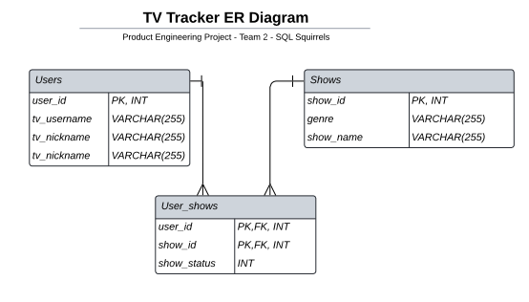
ER Schema

Slide 5
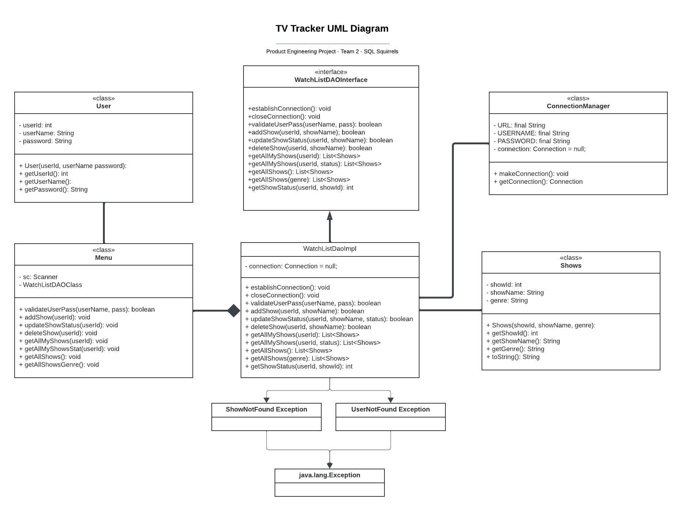
UML Diagram

Slide 6
TV Tracker Demo

Slide 7
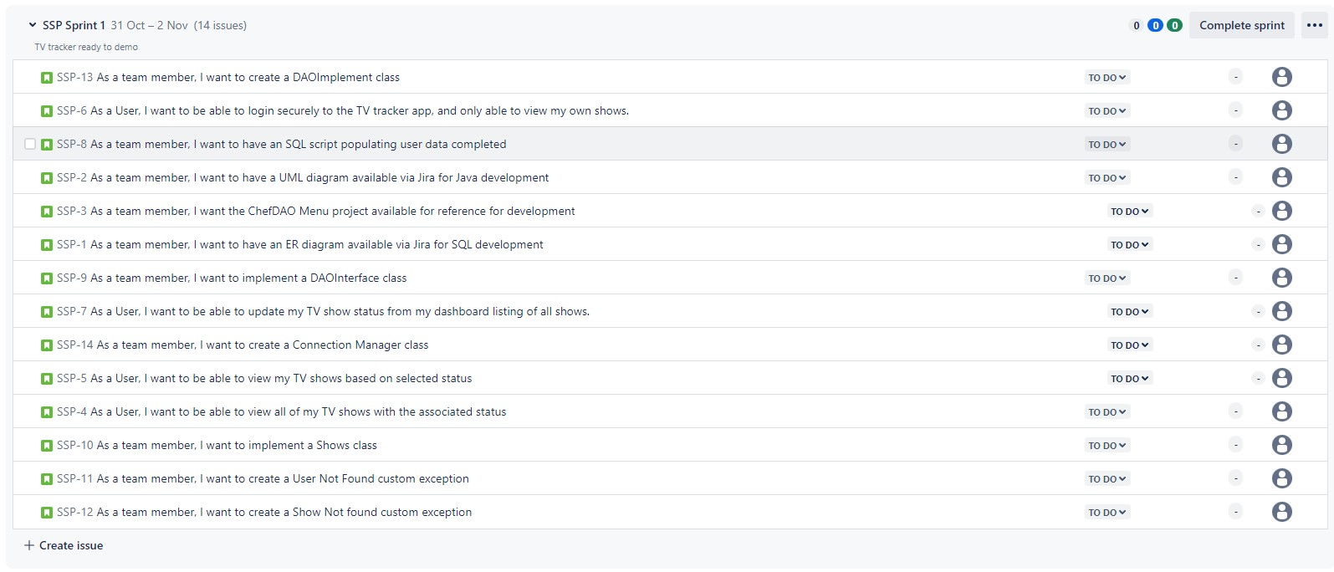
Kanban

Slide 8
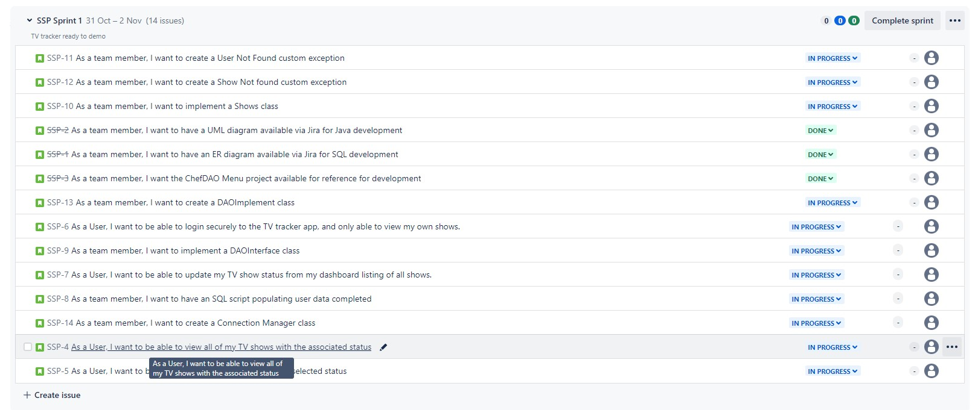
Kanban End of Tuesday

Slide 9
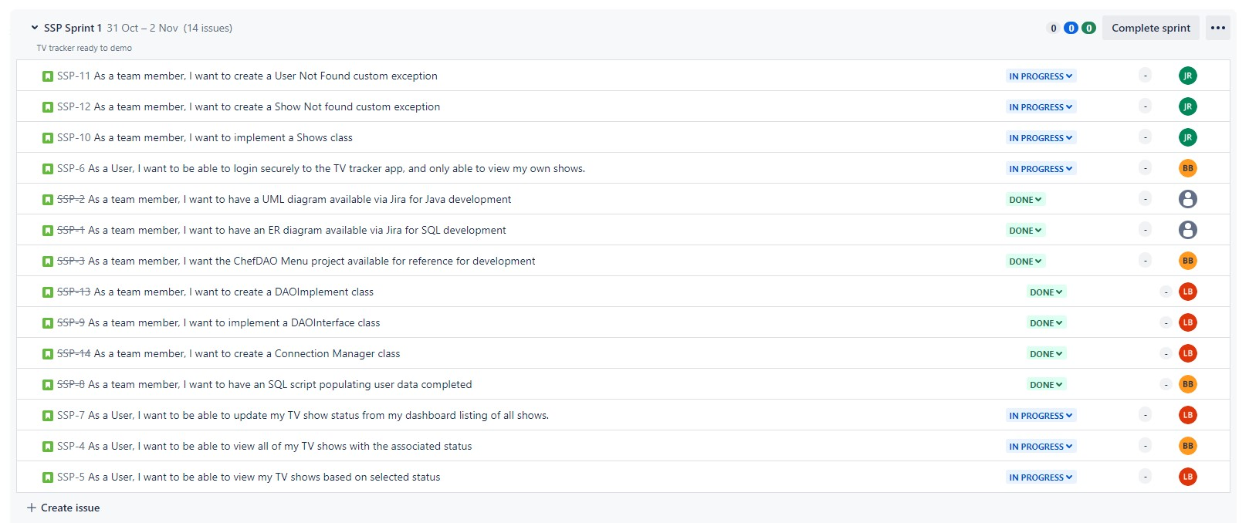
Kanban Wednesday Morning

Slide 10
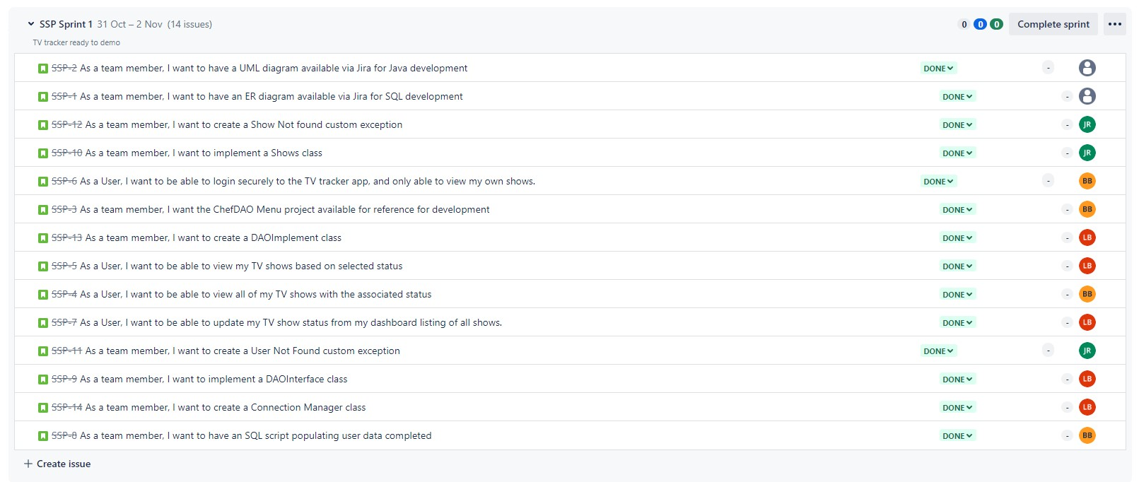
Kanban Wednesday End of Day

Slide 11
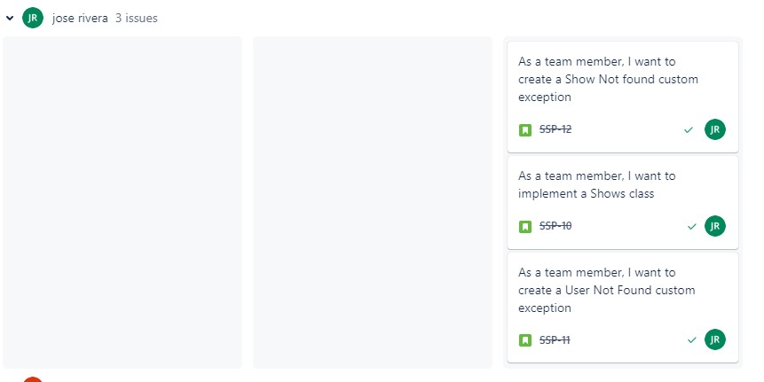
Kanban -Jose
Jose also completed the Main (Runner) class and the Users Class

Slide 12
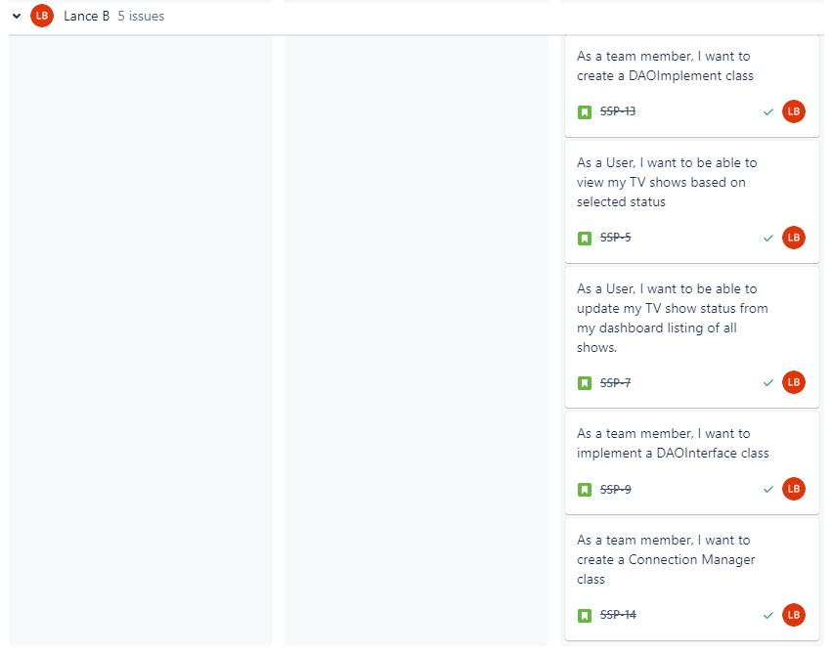
Kanban - Lance

Slide 13
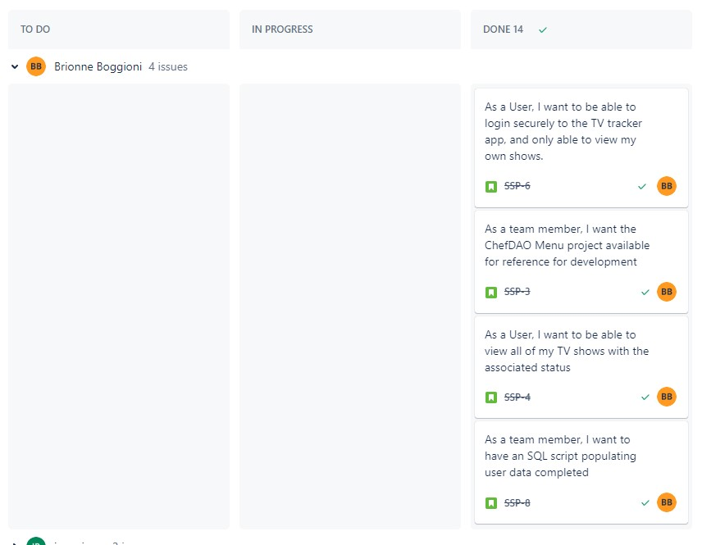
Kanban - Brionne

Slide 14
What did we learn?
Git/Github – duplicate repository issues, nested repository issues.
Input Validation – several iterations trying to account for all possibilities
ER Schema and UML Diagrams are also iterative.

Slide 15
Sprint Review
MVP was achieved within time constraint while maintaining an amicable and collaborative environment.
Congratulations

Slide 16
Sprint Review – Next Steps
Lance – Adding Administration functionality
Jose – Adding Episode/Percentage progress indication
Brionne – Adding Star Rating functionality

Slide 17
Adding Star Rating Functionality
Add Options to Menu “To rate one of my shows”, “Read reviews for a Show”
Add fields to user_shows table: “ratings”, “review”
Add the average stars to the All Shows listing
List anonymous reviews with associated star rating under the show title (when the menu option is used).

Slide 18
Adding Episodes Tracking Functionality
Add an episodes column to the tv_shows table
Add additional attributes to the Shows Object Class (episodes)
Add Implementation in the WatchListImpl Class
Modify updateStatus method in Menu class to accommodate episode tracking

Slide 19
Adding Admin User Functionality
Adding an extra entry and extra field for the tv_users table to account for admins
Add Implementation in the WatchListImpl Class
Prompt anyone who is an Admin a separate Menu to give them admin functions

